Slide 1




Augmented Reality Guided Robotic Manipulation
Wadoud Guelmami
Supervisor: Prof. Carmine Recchiuto

Slide 2

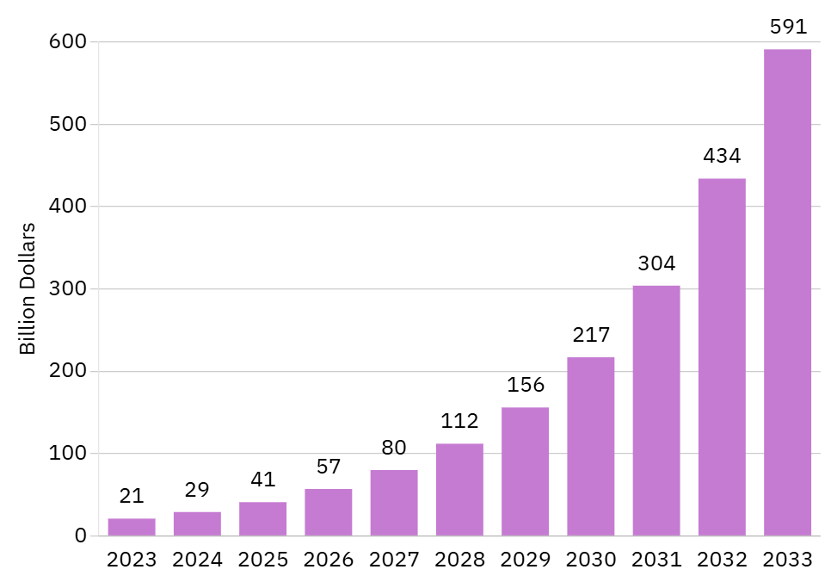
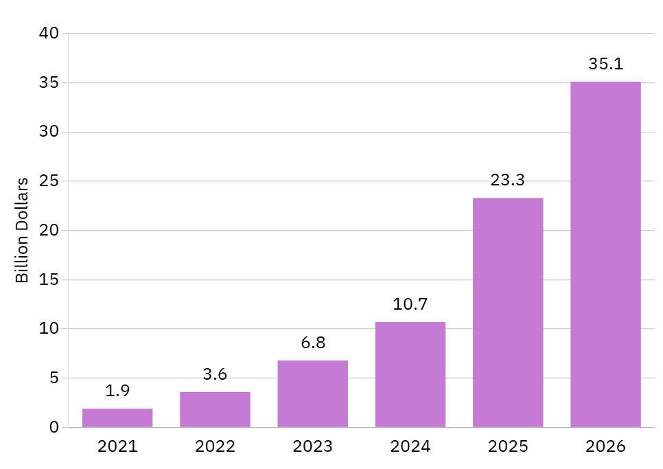
Global Augmented Reality Market Growth [1]
AR Glasses Market Revenues [2]

Slide 3
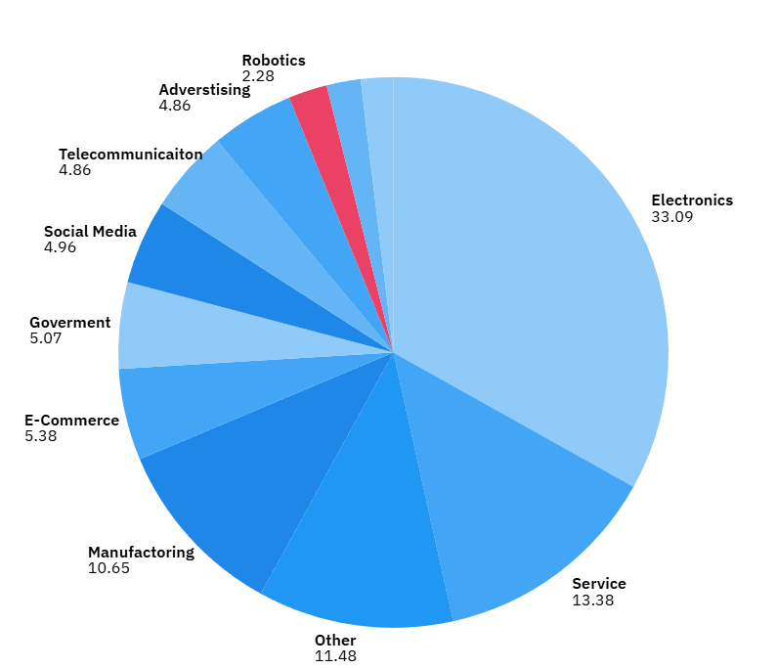
AR Segmentation By Industry

Slide 4



?
Hololens2
Franka Robot

Slide 5
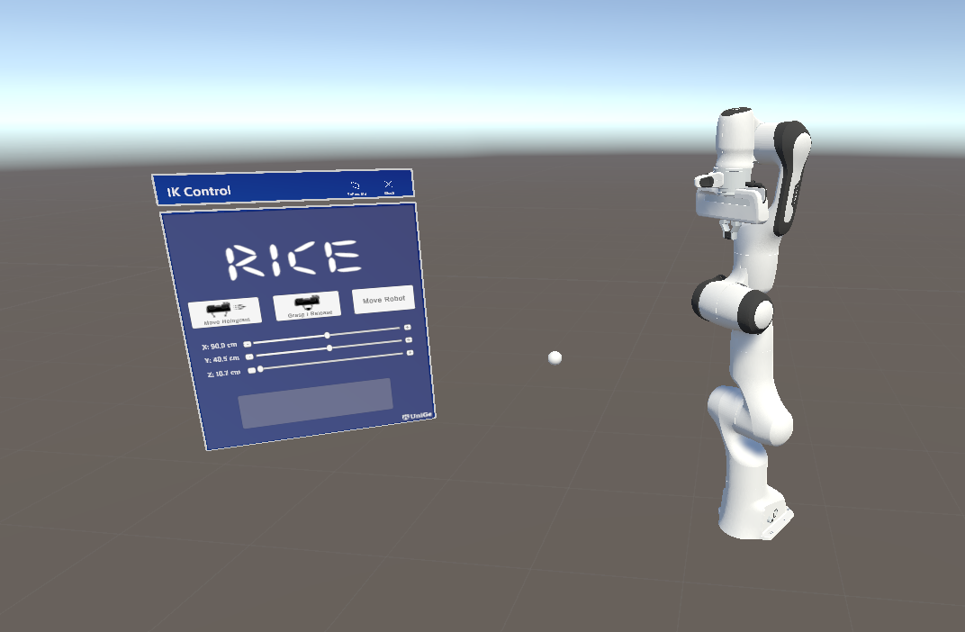
The Developed Solution

Slide 6
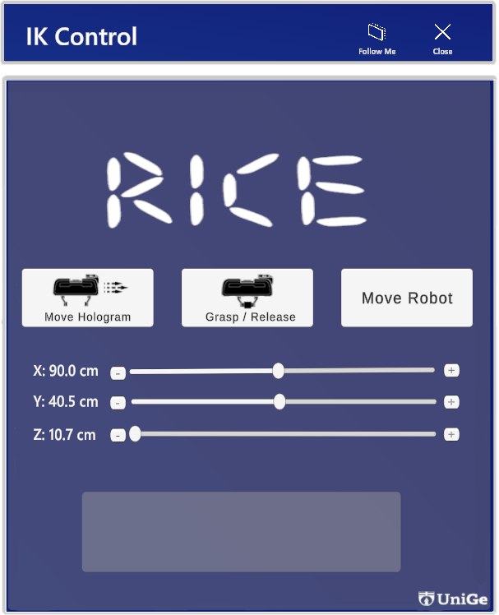

The interface enables users to control the system through three main functions: moving the hologram, controlling the gripper, and executing motion on the real robot.
The feedback box ensures real-time updates by confirming coordinate transmission, gripper status, and execution success, improving user confidence.
Bidirectional synchronization between the sphere and sliders ensures real-time updates
X: 90.0 cm
Y: 40.0 cm
Z: 10.7 cm

Slide 7
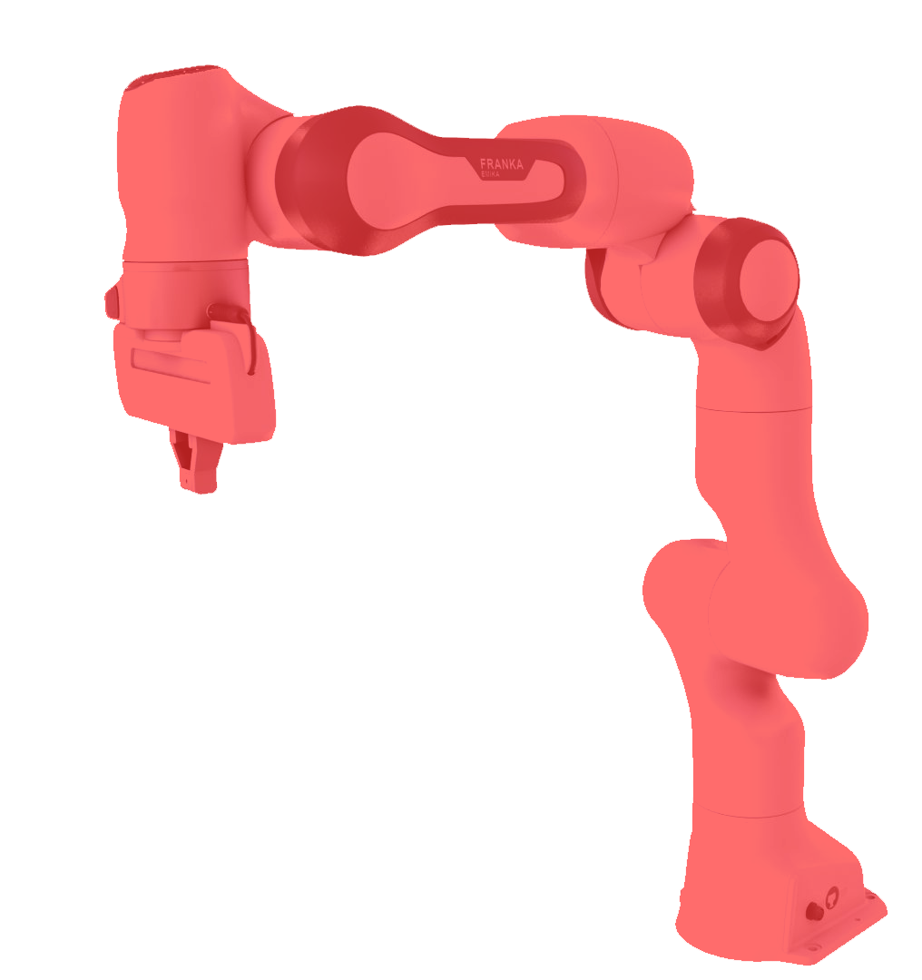
Out Of Workspace !
The system checks if the sphere is outside the robot’s workspace and gives a visual warning to help the user.
The holographic robot signals in red to get the attention of the user.
Once the user renters the workspace turns back into the normal form.
The workspace is measured manually till the possibile reachable point by both Holographic and real robot.
Far
X: 905.0 cm
Y: 1400.0 cm
Z: 100.7 cm

Slide 8
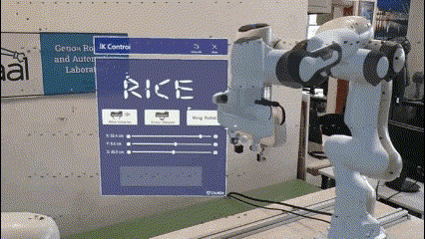
Contents of this template
You can delete this slide when you’re done editing the presentation
Fonts | To view the template correctly in PowerPoint, download and install the fonts we used
Used and alternative resources | An assortment of graphic resources that are suitable for use in this presentation
Thanks slide | You must keep it so that proper credits for our design are given
Colors | All the colors used in this presentation
Icons and infographic resources | These can be used in the template, and their size and color can be edited
Editable presentation theme | You can edit the master slides easily. For more info, click here
For more info: SLIDESGO | BLOG | FAQs
You can visit our sister projects: FREEPIK | FLATICON | STORYSET | WEPIK | VIDEVO

Slide 9
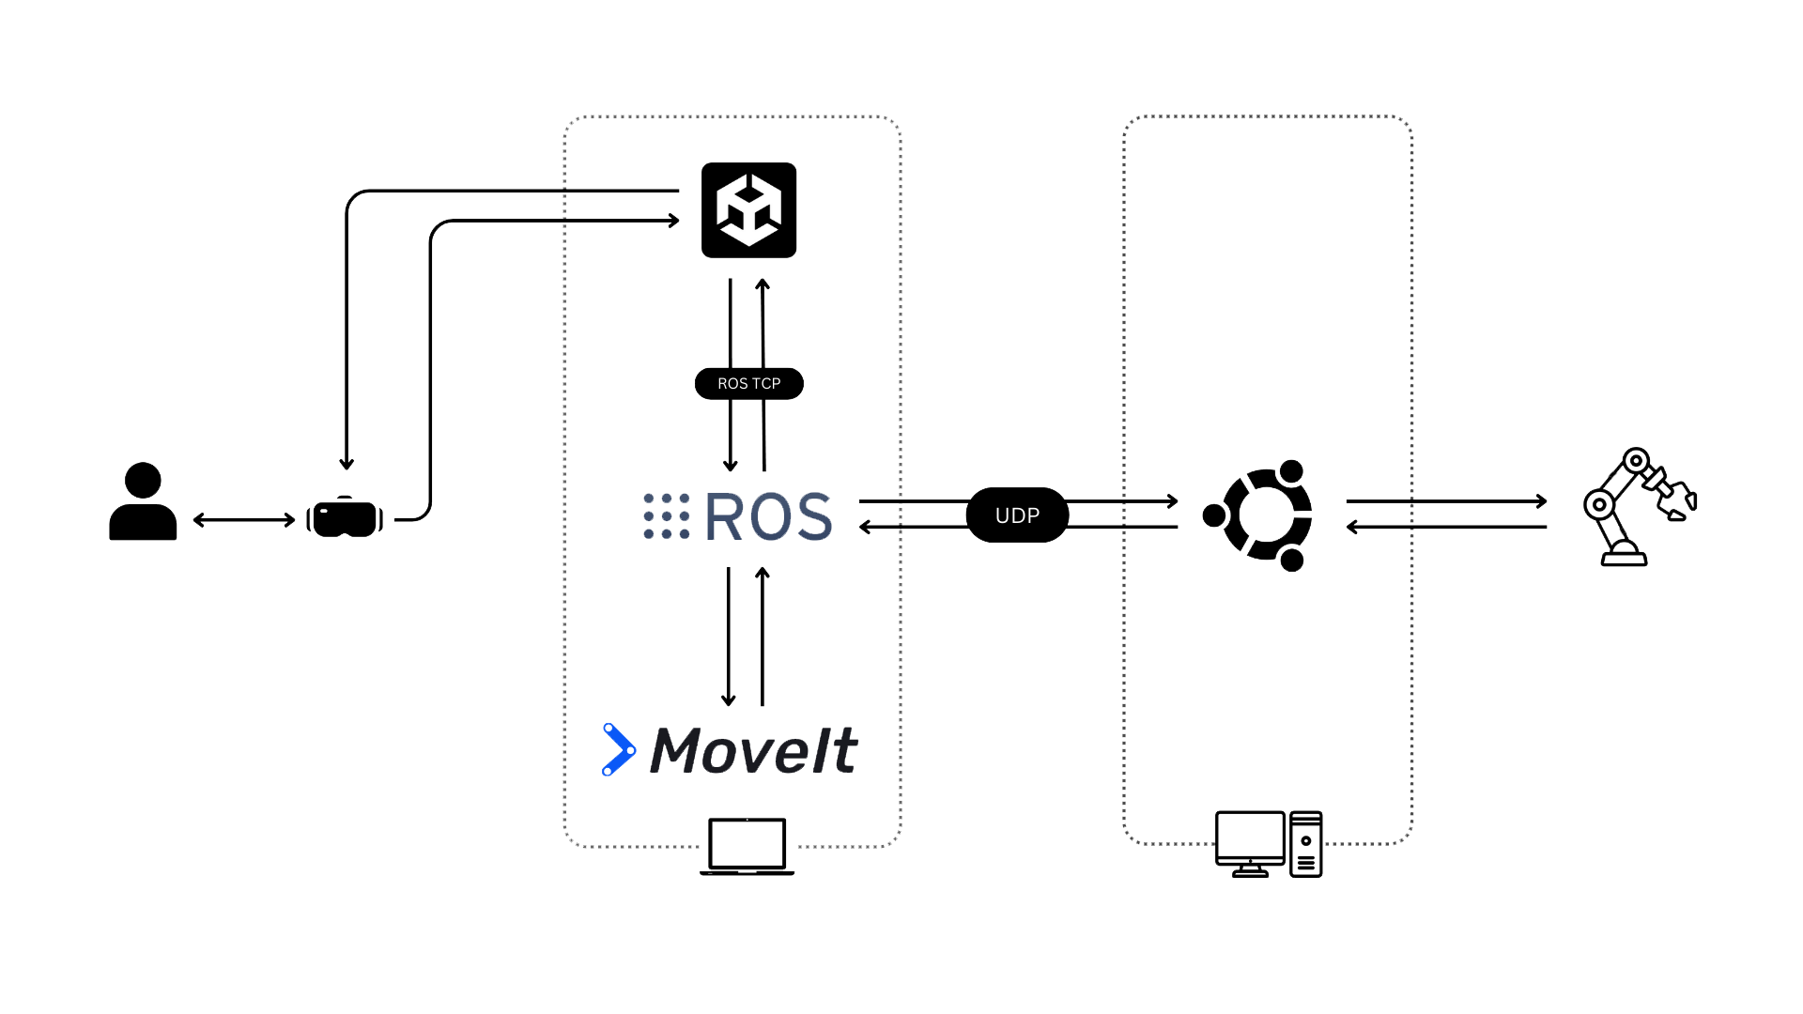
Hologram
Feedback
Move
Grasp
Release
Orders
Move
Grasp
Release
Orders
Joint
States*
Joint
States*
Interaction
Move
Grasp
Release
Orders
Feedback
Solution
Execute motion
Real Robot
System WorkFlow

Slide 10
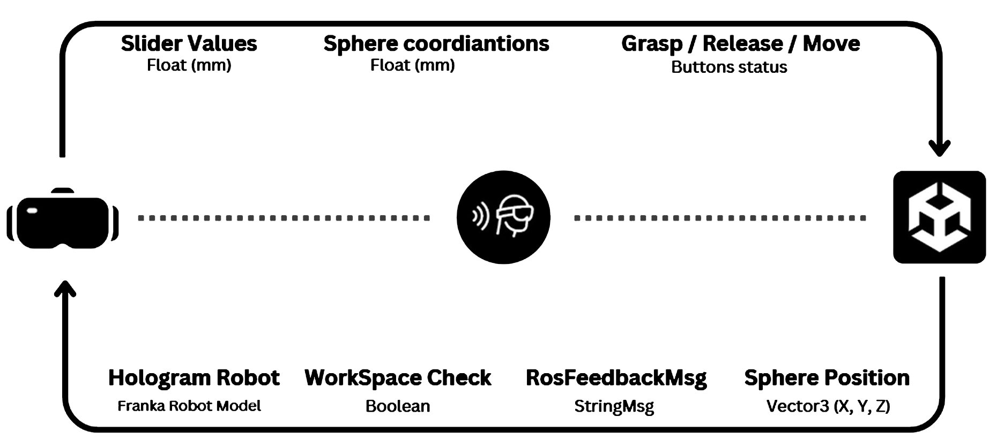
Holographic remoting Player

Slide 11
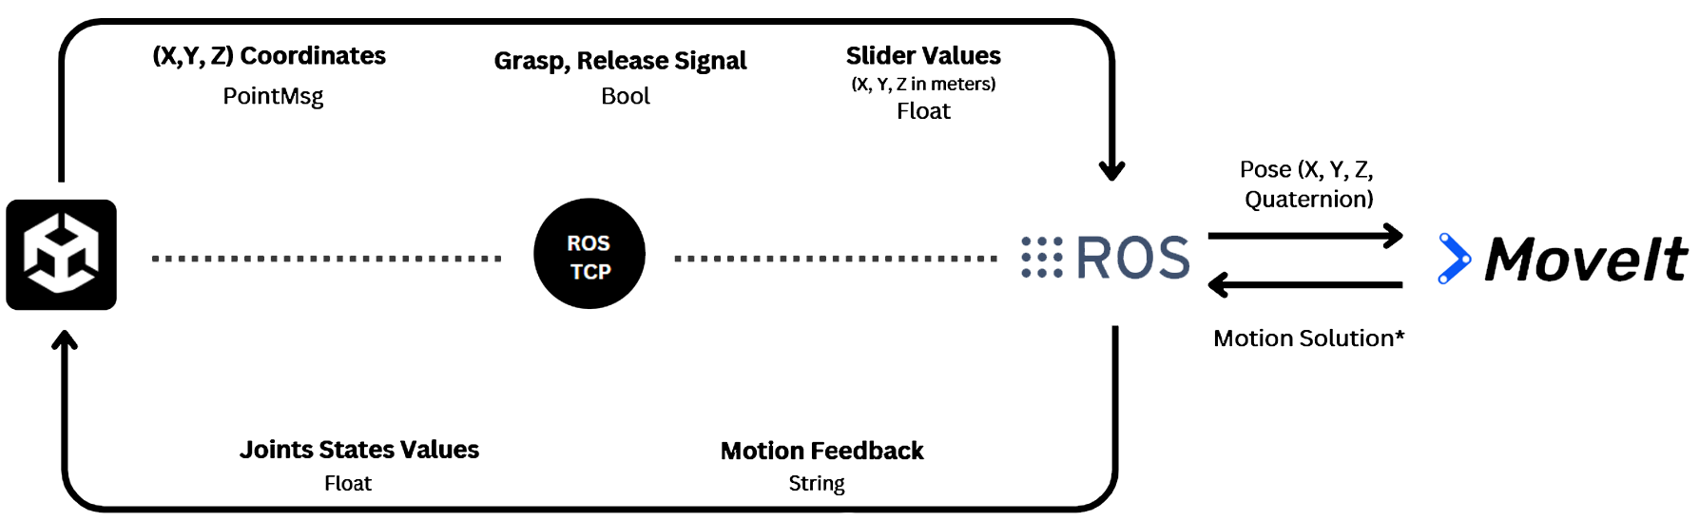
Unity & ROS

Slide 12

Programming Language: It uses C# to program Scripts such as FeedbackListener.cs, JointStateSubscriber.cs, and SliderValuePublisher.cs
Data Exchange: Using ROS TCP Connector.
Publishing: Unity publishes user-defined goals (e.g., target positions, gripper commands) to ROS topics using the ROS TCP Connector such as /unity_coordinates topic, and gripper commands are published to the /grasp_signal topic.
Subscribing: Unity subscribes to Joint States & feedback topics from ROS to reflect the robot’s state to the Articulation body of the robot model.
Other Functions: Responsible for WorkspaceChecking, Broadcasting the virtual scene, Synchronization between the sliders values and Sphere.

Slide 13

Programming Language: Python (Unity_coordinate Listener.py), C++ (Pos_udp_sender.cpp)
Data Exchange: The ros_tcp_endpoint package is used to set up a TCP server that listens for messages from Unity.
Subscribing: ROS subscribes to topics for incoming commands such as /unity_coordinates that receives Cartesian coordinates for arm movement. /grasp_signal receives Boolean signals to control the gripper.
Publishing: Publishes feedback through topic \unity_feedback Sends status updates (e.g., " Coordinations received, IK Solving ") back to Unity.

Slide 14

Type of Motion: Cartesian Space Control. The function move_to_cartesian_goal(x, y, z) commands the end-effector to reach a specific position in Cartesian space.
Uses Inverse Kinematics (IK) to compute joint angles corresponding to the given Cartesian pose.
Implements a fixed end-effector orientation (downward-facing, set by quaternion_from_euler(3.14159, 0, 0))
The function move_fingers(position, feedback_msg) moves the finger joints using joint values

Slide 15
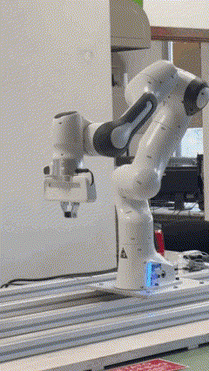
Control Type: Joint Position Control
It moves to the desired positions (Joint positions) using a MotionGenerator, which is a position-based controller.
Loop Type: Semi-Open-Loop
The MotionGenerator does not rely on continuous feedback to adjust the movement dynamically but instead executes a trajectory based on the given goal.
Execution: The robot moves to each new joint position reference in a predefined way without real-time adjustments.

Slide 16
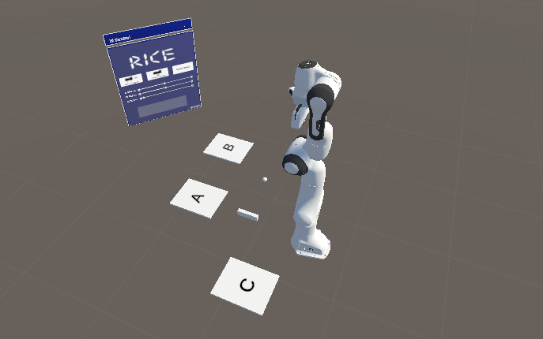
Experiment To Test Usability and Workload

Slide 17


SUS
NASA TLX
Usability Test
Workload Test
A simple method to evaluate the usability of a system.
Consists of 10 questions (1 Strongly Disagree— 5 Strongly
Agree).
Helps identify usability issues and improve system design.
Widely used across different industries.
Measures the Workload of system.
Focuses on 6 mains dimensions: Mental, physical and Temporal Demand, Frustration, Efforts, Performance.
Widely used by different industries.

Slide 18


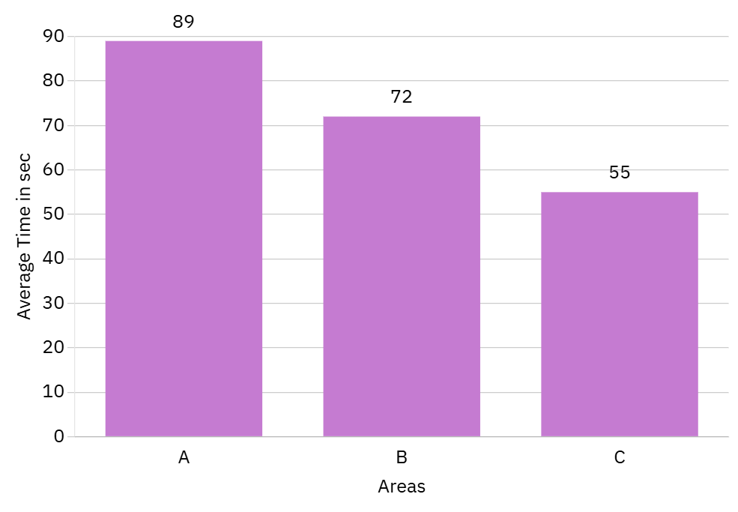
Results
Task Completion Time Trend: Execution time decreases across Areas A, B, and C, showing improved efficiency.
System Learnability: Users adapt to HoloLens and robotic control, leading to faster interactions.
Performance Improvement: Confidence grows from Area A to C, reducing cognitive effort and increasing speed.
Usability Validation: The results confirm that the system is intuitive and learnable, allowing users to enhance their efficiency over time.
Average Completion Time of the 10 Volunteers

Slide 19
Results
SUS
High Usability Rating: The SUS score of 88 classifies the system as "Excellent", confirming ease of use.
Improved Performance Over Time: The high SUS score aligns with faster task completion times, showing users adapted quickly.
88%

Slide 20
Results
NASA
TLX
Moderate Workload: The NASA-TLX average score of 34.8 indicates a moderate cognitive effort was needed.
Balanced Usability: The system required some thinking and effort, but it was not too difficult to use.
Task Impact Analysis: Different factors influenced user experience, highlighting areas for potential optimization.
34.8%

Slide 21
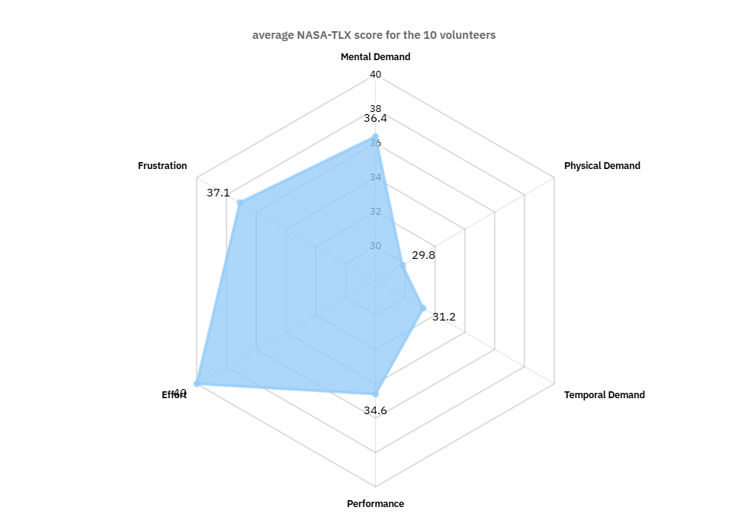
Results
Effort Required: Effort scored 40.0, indicating users had to exert some energy to complete tasks.
Low Physical Demand: Physical Demand scored 29.8, meaning the task was not physically tiring.
Moderate Cognitive Load: Mental Demand (36.4) and Temporal Demand (31.2) show users had to think but did not feel rushed.
User Experience Insights: Performance (34.6) suggests users felt competent, while Frustration (37.1) indicates minor annoyance but not excessive difficulty.

Slide 22





Limitations
Limited Field of View: The HoloLens 2 only provides a 52° field of view, making it challenging to see a wide workspace.
Delayed Motion Planning: Users experienced slow response times due to MoveIt’s computation delay in generating robot movements.
Hologram Calibration Challenge: Precise alignment of the virtual and real robot is crucial but can be difficult to achieve.
Manual Execution Requirement: The system requires manual confirmation before executing movements on the real robot, ensuring controlled interaction.

Slide 23





Suggestions
Alternative Control System: Replacing MoveIt with a more optimized motion planner can reduce execution time and improve efficiency.
Forward Kinematics (FK) Implementation: Adding joint control sliders would allow users to manually adjust each joint without affecting others, improving flexibility.
Automatic Calibration: Using an Aruco marker for automatic calibration can precisely align the holographic and real robot, eliminating manual adjustments.
Automatic Mode Execution: Enabling direct robot movement without requiring user confirmation each time would enhance speed and usability.

Slide 24


Conclusion
AR makes robot control accessible to Non-Experts, removing the need for specialized programming skills or complex interfaces.
AR-Based robot control can be a desirable option for the traditional solutions
The system has potential for multi-user support and compatibility with different robots, making it a scalable solution for AR-based robotic control.
AR strengthens the connection between human intuition and robotic execution, which alludes to a promising future.

Slide 25

Resources
[1]: https://www.marketsandmarkets.com/Market-Reports/augmented-reality-market-82758548.htm
[2] : https://scoop.market.us/augmented-reality-statistics/
[3] : https://scoop.market.us/augmented-reality-statistics
[4] : https://www.flaticon.com/
[5] : https://www.interaction-design.org/literature/article/system-usability-scale
[6] : https://humansystems.arc.nasa.gov/

Slide 26

Thank You
I welcome any questions

